Slide 1
Project Risk Management

Slide 2
The Importance of Project Risk Management
Project risk management is the art and science of identifying, analyzing, and responding to risk throughout the life of a project and in the best interests of meeting project objectives
Risk management is often overlooked in projects, but it can help improve project success by helping select good projects, determining project scope, and developing realistic estimates
Information Technology Project Management, Fifth Edition, Copyright 2007

Slide 3
Negative Risk
A dictionary definition of risk is “the possibility of loss or injury”
Negative risk involves understanding potential problems that might occur in the project and how they might impede project success
Negative risk management is like a form of insurance; it is an investment
Information Technology Project Management, Fifth Edition, Copyright 2007

Slide 4
Project risks vs. other risks
Other risks such as business risks or security risks
They are different
Business risks are about profitability
Security risks are about the probability of breaking the system security
Project risks are about the probability for the project to fail
Each probability has a different ground that leads to the risk occurrence

Slide 5
Risks Management Processes
The techniques have some common ground, e.g.:
  Identify risk factors
  Estimate a probability and an impact
Risk factors are entirely different

Slide 6
Project Risk Management Processes
Risk management planning…
Risk identification: determining which risks are likely to affect a project and documenting the characteristics of each
Qualitative risk analysis: prioritizing risks based on their probability and impact of occurrence
Quantitative risk analysis: convert risk impact into figures (for example $$$) and prioritize
Risk response planning: taking steps to…reduce threats to meeting project objectives
Information Technology Project Management, Fifth Edition, Copyright 2007

Slide 7
Project Risk Management Processes (continued)
Risk monitoring and control: monitoring identified and residual risks, identifying new risks, carrying out risk response plans, and evaluating the effectiveness of risk strategies throughout the life of the project
Information Technology Project Management, Fifth Edition, Copyright 2007

Slide 8
Risk Identification
Risk identification is the process of understanding what potential events might hurt … a particular project
Risk identification tools and techniques include:
  Brainstorming
  The Delphi Technique
  Interviewing
  Strengths, Weaknesses, Opportunities, and Threats (SWOT) analysis
Information Technology Project Management, Fifth Edition, Copyright 2007

Slide 9
Brainstorming
Call your development team to the meeting
Have an intelligent discussion re the project risks
Facilitate the discussion:
  Collect information from external resources (experts, books, Internet)
Collect the ideas and categorize them
Prioritize risk factors

Slide 10
Delphi Technique
During the group discussion some negative effects may occur, e.g. someone opinions prevail the other people opinions
Delphi technique help eliminating negative effects
Is based on a special procedure of interviewing experts
Details are out of scope

Slide 11
Interviewing
Another most commonly used technique, after brainstorming
Talk to experts
Talk to ones who have completed similar projects recently
Before interviewing, have an initial list of questions but be prepared to change it during the interview

Slide 12
SWOT Analysis
In terms of the project, discuss Strengths, Weaknesses, Opportunities, and Threats (S, W, O, and T)
Keep focused on the project objectives and scope
Watch for threats from external entities (other projects, contractors, vendors, etc)

Slide 13
SWOT analysis
Examples – Install Anti-virus solution
S – we have already antivirus protection installed once
W – we have no experience with antivirus software deployment
O – this vendor offers us a significant discount
T – the vendor is at the acquisition, who knows what may happen

Slide 14
Broad Categories of Risk
Market risk
Financial risk
Technology risk
People risk
Structure/process risk
Network security projects are most susceptible to financial and technology risks, however other kinds of projects are susceptible to all categories of risks

Slide 15
Risk Register
The main output of the risk identification process is a list of identified risks and other information needed to begin creating a risk register
A risk register is:
  A document that contains the results of various risk management processes and that is often displayed in a table or spreadsheet format
  A tool for documenting potential risk events and related information
Information Technology Project Management, Fifth Edition, Copyright 2007

Slide 16
Risks Evaluation
Assess the likelihood and impact of identified risks to determine their magnitude and priority
Risk evaluation tools and techniques include:
  Probability/impact matrices
  The Top Ten Risk Item Tracking
  Expert judgment
Information Technology Project Management, Fifth Edition, Copyright 2007

Slide 17
Probability/impact matrices
The chart built to show correlation between probability and impact
P
r
o
b
a
b
i
l
I
t
y
Risk6 | Risk9 | Risks 1 and 4
Risks 3 and 7 | Risks 2, 5, and 11
 | Risks 8 and 10 | Risk 12
High
Medium
Low
Low
Medium
High
Impact

Slide 18
Top Ten Risk Item Tracking
Top Ten Risk Item Tracking is a qualitative risk analysis tool that helps to identify risks and maintain an awareness of risks throughout the life of a project
Establish a periodic review of the top ten project risk items
List the current ranking, previous ranking, number of times the risk appears on the list over a period of time, and a summary of progress made in resolving the risk item
Information Technology Project Management, Fifth Edition, Copyright 2007

Slide 19
Risk Response Planning
After identifying and quantifying risks, you must decide how to respond to them
Four main response strategies for negative risks:
  Risk avoidance
    You may decide to avoid doing business with a new vendor
  Risk acceptance
    You accept a new vendor
  Risk transference
    You apply a 3rd party service instead of doing your own business
  Risk mitigation
    You find the way to address and control risk

Slide 20
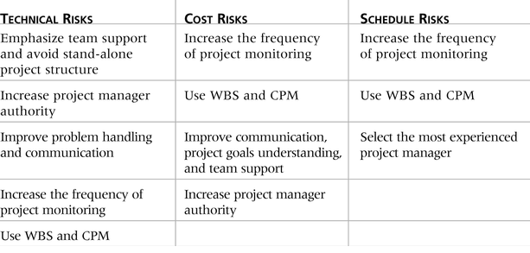
Table 11-7: General Risk Mitigation Strategies for Technical, Cost, and Schedule Risks
CPM – critical path method
Information Technology Project Management, Fifth Edition, Copyright 2007

Slide 21
Risk Management Plan
Create the plan at the project planning stage
Generally the plan contains:
  Methodology
  Roles and responsibilities
  Budget and schedule
  Risk categories
  Risk probability and impact
  Stakeholders tolerance
  Tracking
  Risk documentation

Slide 22
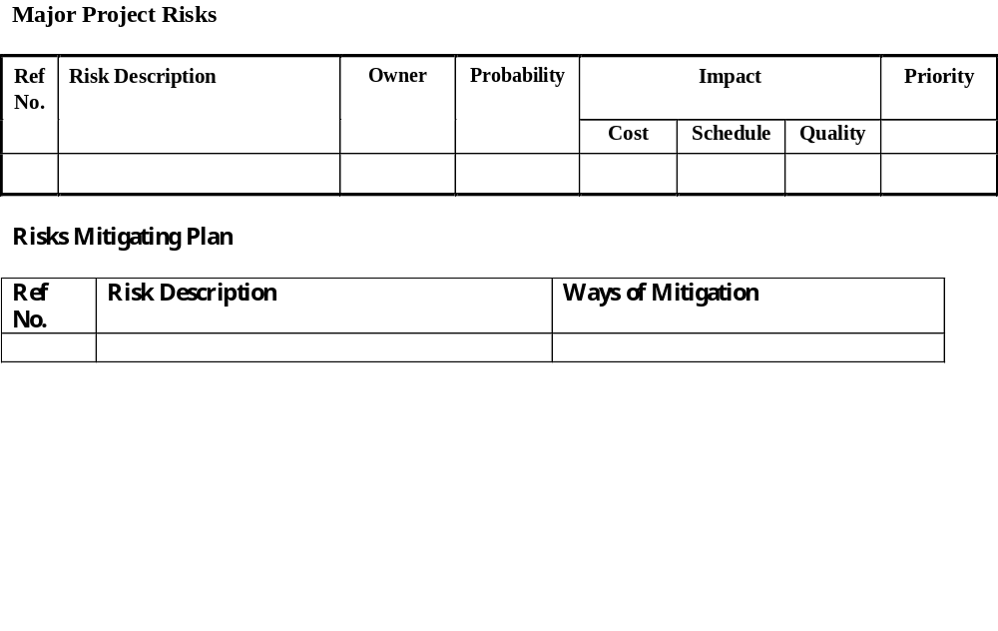
Sample forms

Slide 23
Risk Monitoring and Control
Involves executing the risk management process to respond to risk events
Workarounds are unplanned responses to risk events that must be done when there are no contingency plans
Main outputs of risk monitoring and control are:
  Requested changes
  Recommended corrective and preventive actions
  Updates to the risk register, project management plan, and organizational process assets
Information Technology Project Management, Fifth Edition, Copyright 2007

Slide 24
Results of Good Project Risk Management
Unlike crisis management, good project risk management often goes unnoticed
Well-run projects appear to be almost effortless, but a lot of work goes into running a project well
Project managers should strive to make their jobs look easy to reflect the results of well-run projects
Information Technology Project Management, Fifth Edition, Copyright 2007

Slide 25
Risks management for security projects
Overall methodology is the same
Risk factors to consider first of all:
  People (not acceptance of new security mechanisms)
  Technology (new technology brings not only resolution of the existing security issues but it brings also other security issues)

